Slide 1
LAC Pass Projectathon
Registration Webinar
01-03-2022
Carlos Nunez – CENS
Alexander Berler – IHE Catalyst
Souleymane THIAM – IHE Catalyst

Slide 2
Agenda
Overview and scope
The concept of the projectathon
Event organization
Overview of Gazelle Test Management
Registration process in Gazelle
Documentation & Communication
Q&A

Slide 3

Bien Público Regional - BPR Salud Digital

Slide 4
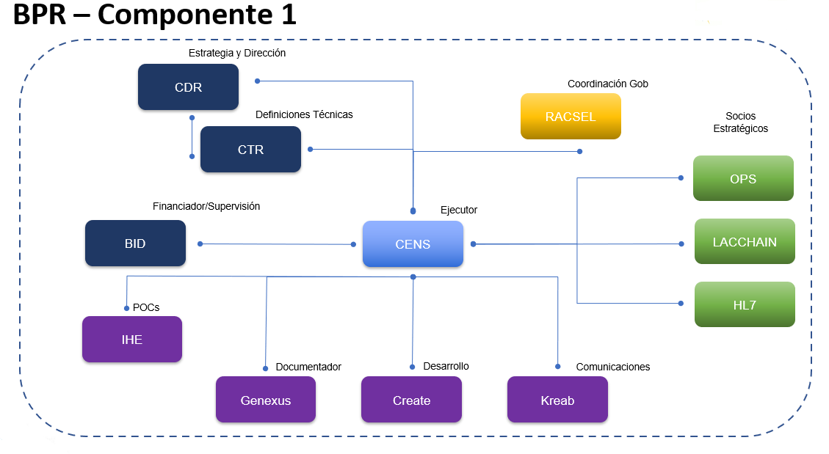
BPR – Componente 1

Slide 5
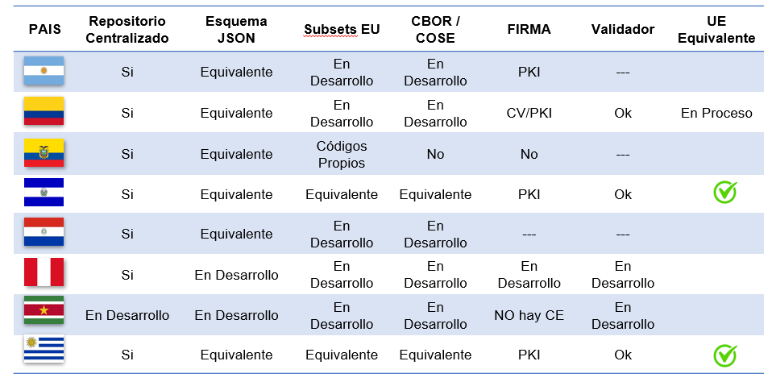
Avance de Países

Slide 6
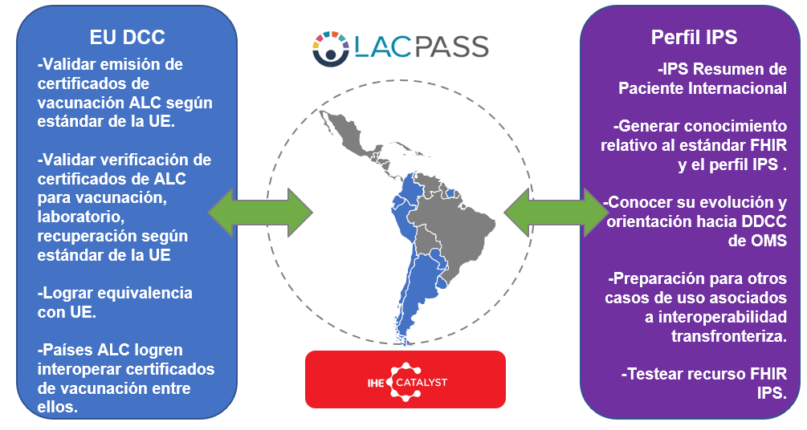
Alcance

Slide 7
Realizing Interoperability is about teamwork
Standards
Establish base standards
Pre Production Tests
Use Cases
Pre Production Testing of Pilots and operational deployments
Identify Business Use Cases and derive key Profiles as global building blocks
Projectathon Validation
Connectathon Validation
Combine Profiles to address business use case for a specific deployment project
Test implementations of each Profile along with test tools

Slide 8
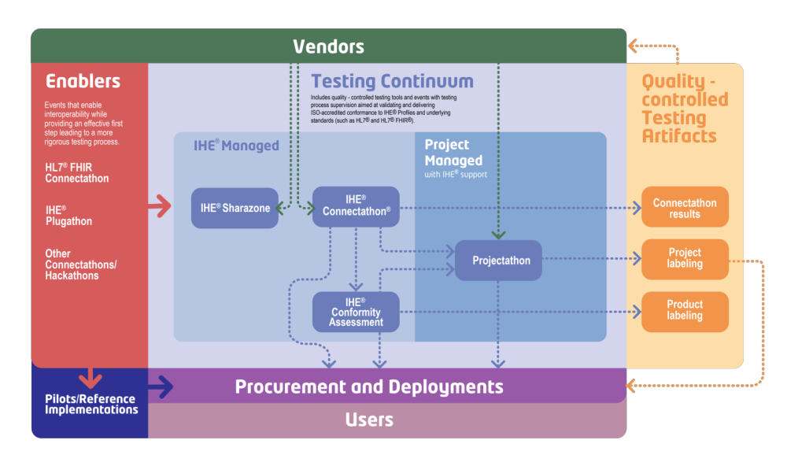
The Testing Continuum

Slide 9
What is a Projectathon?
A projectathon is a peer-to-peer testing event that is organized as a Connectathon® where the interoperability specifications that are tested are those of a national, regional or other project.
Those specifications are localizations of IHE integration profiles that take into account also additional local specifications and constraints
Projectathons usually incorporate muti-actors and multi-transactions sequences that map real life health information exchange
Projectathons use the same tools as those used in Connectathons®

Slide 10
Why do Projectathons?
Enable co-creation of interoperability specifications at a national, regional or project level
  country level examples: Ireland, Greece, France, Luxembourg
  regional level example: Abrumet, Veneto, Friuli Venezia Giulia
  project level example: epSOS, UNICOM, eHDSI, WHO DDCC
Test and refine the quality of interoperability specifications
Create a reference implementation before production or certification
Digital health ecosystem

Slide 11
Event Organization : Projectathon Phases
Registration
Pre-Projectathon Tests
Connectivity Tests
Projectathon

Slide 12
Projectathon milestones and calendar
February
March
April
May
Registration
from March 01st to March 31st
Pre-projectathon tests
from March 28th to April 22th
PAT
May 2- 4
Late registration
Connectivity tests (11/04 – 22/04)
Registration Webinar
01/03
Pre- Testing Webinar
28/03
Connectivity tests Webinar
22/04
Report publication
Legend
16/05
Follow-up meeting
Webinar
28/04
PAT Managemen team
Participants

Slide 13
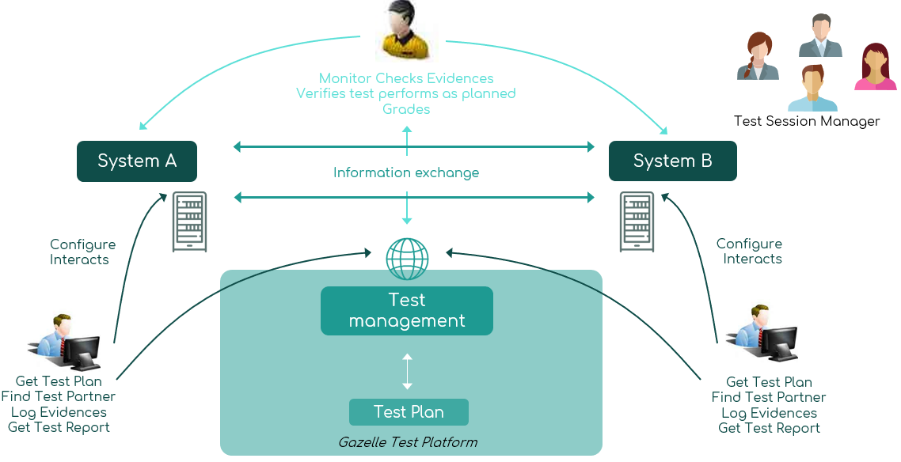
Event Organization

Slide 14
Event Organization : Monitors
Objectives
Support the technical team by answering questions from participants about the interoperability specifications
Verify the test cases and grade them
Who
Volunteers with experience in health care standards
May have knowledge on IHE
No conflict of interest (shall not work for an implementer)
How
Monitors will be selected based on their skills and the number of registered systems by March 14th

Slide 15
Overview of Gazelle TM
Gazelle
  test management tools oriented toward interoperability & conformance testing
  a suite of IHE actors simulators
  a suite of IHE validators
  a suite of tools for testing support
    Tools for data generation
A set of tools that can be used for testing the interoperability and the conformance of eHealth Information Systems
  For IHE connectathon
  For Vendors implementing eHealth Standards
  For Users deploying and using eHealth Information Systems
  For conformity assessment testing

Slide 16




























Overview of Gazelle TM
Arsenal.IT (Italy Venice Region)
Abrumet-Brussels eHealth (Belgium)
Insiel SPA (Italy)
InteropSanté - France
GE
Agfa
Medical PHIT (NL)
Technikum Wien (Austria)
IHE USA
IHE-Europe
IHE China
IHE Japan
Agence eSanté-Luxembourg
InterAMC France
eHealth Finland
eHealthSuisse & Federal MoH
eHealthPlatform Belgium
EU DG Santé-European Cross Border
Sequoia-USA
EFS-French Blood Transfusion-France
Saudi Arabia eHealth: SHC-KSA
Ireland eHealth (HSE)
French ehealth (ANS)
Gabon MoH
Greece MoH

Slide 17
Gazelle for LacPass
LAC Testbed
Dedicated instance of the Gazelle Test Tools
Adapted to test the EU DSS Specifications
Contains all the tools to prepare your system for the event
https://gazelle.racsel.org/

Slide 18
Demonstration
Registration process

Slide 19
Demonstration : Registration process
Exercise
I am Mr Renato Sanchez from the company Demo Healthcare.
I want to make a registration in Gazelle in order to participate to the upcoming PAT.
I will test my MHD implementation and I will act as a consumer.

Slide 20
Communication
Get Support
  Technical Manager – Souleymane THIAM
    souleymane.thiam@kereval.com
    LACPass-pat-manager@ihe-catalyst.net
  Report issues on testing tools and ask questions
  Helpdesk at https://gazelle.ihe.net/jira/servicedesk/customer/portal/33
  Contact the test session manager to get access

Slide 21

Communication
Rocket.Chat (open source software)
• Communication via channels, private group, direct messages…
• Video calls with jitsi
Moodle
Google Group

Slide 22
Documentation
Useful Links
DGC:
https://github.com/eu-digital-green-certificates
EHN:
https://github.com/ehn-dcc-development
LACpass :
https://github.com/RACSEL/LacPass/blob/main/doc/es/introduction.md
Documentation for the Gazelle platform
https://gazelle.racsel.org/gazelle-documentation/

